Slide 1
Nanoscale thermal transport
Lecture 5
Riley Hanus
http://rileyhanus.com/science.html

Slide 2
Wavelength, coherence length, mean free path, and relaxation time
Example Callaway model
Explore how different scattering mechanisms influence thermal conductivity versus temperature
Point defects
Interfaces
Explore low and high temperature limits
Lattice softening
Mean free path accumulation

Slide 3
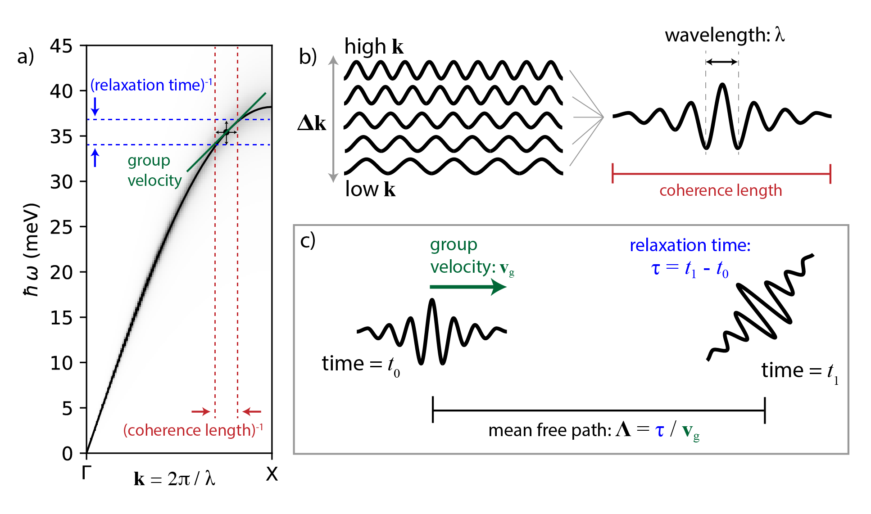
Review wave packet basics

Slide 4
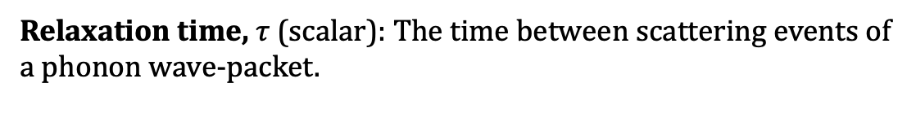
Review wave-packet basics
Relaxation time, $τ$ (scalar): The time between scattering events of a phonon wave-packet.

Slide 5
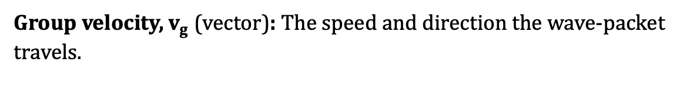
Review wave-packet basics
Group velocity, $v_{g}$ (vector): The speed and direction the wave-packet travels.

Slide 6
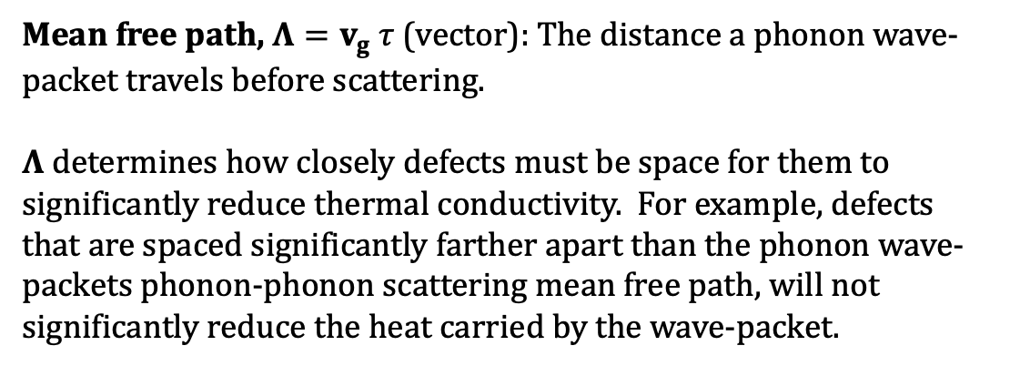
Review wave-packet basics
Mean free path, $Λ=v_{g} τ$ (vector): The distance a phonon wave-packet travels before scattering.
$Λ$ determines how closely defects must be space for them to significantly reduce thermal conductivity. For example, defects that are spaced significantly farther apart than the phonon wave-packets phonon-phonon scattering mean free path, will not significantly reduce the heat carried by the wave-packet.

Slide 7
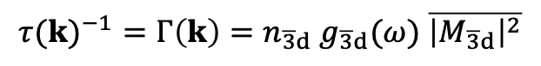
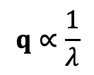
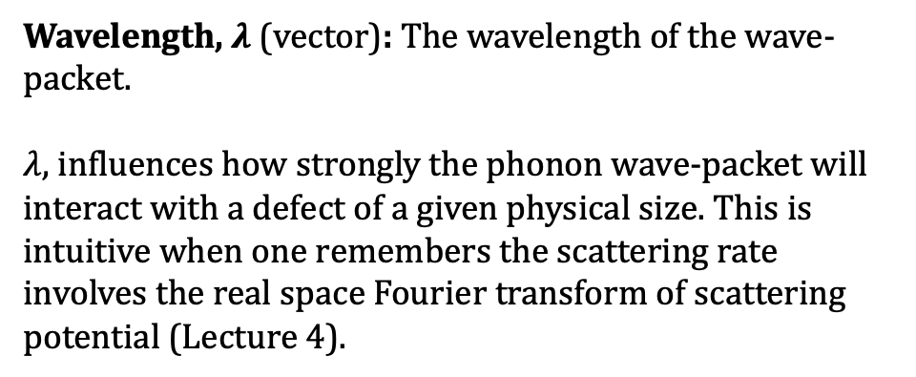
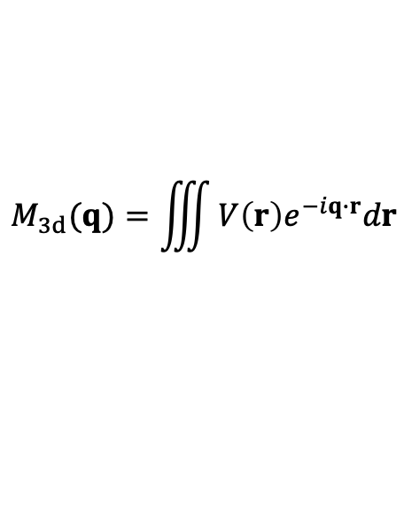
Review wave-packet basics
$${τ(k)}^{−1}=Γ\left(k\right)=n_{\overline{3}d} g_{\overline{3}d}(ω) \overline{{\left|M_{\overline{3}d}\right|}^{2}}$$
$$M_{3d}(q)=\iiint{V\left(r\right)e^{−iq∙r}dr}$$
$$q∝\frac{1}{λ}$$
Wavelength, $λ$ (vector): The wavelength of the wave-packet.
$λ$, influences how strongly the phonon wave-packet will interact with a defect of a given physical size. This is intuitive when one remembers the scattering rate involves the real space Fourier transform of scattering potential (Lecture 4).

Slide 8
Review wave-packet basics
Coherence length (vector): The distance over which the atomic vibrations are correlated to one another.
Ideal plane waves have an infinite coherence length. These do not exist in nature. In reality, there is a distance beyond which the vibration of atoms are uncorrelated.

Slide 9
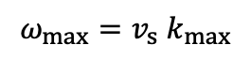
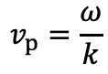
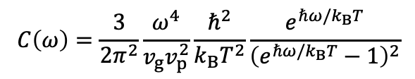
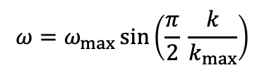
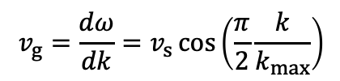
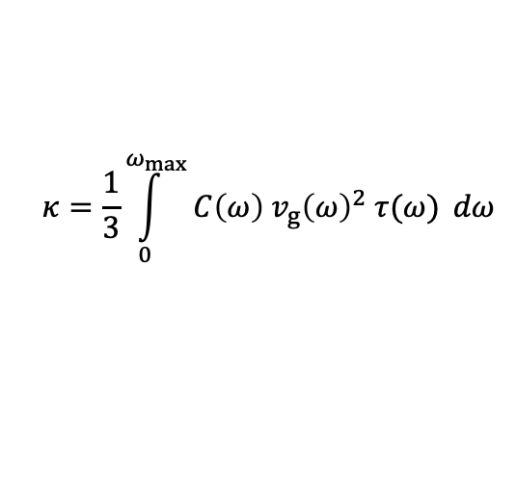
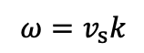
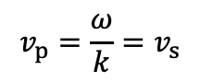
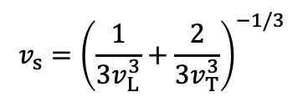
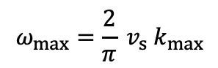
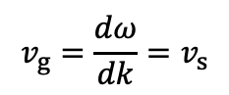
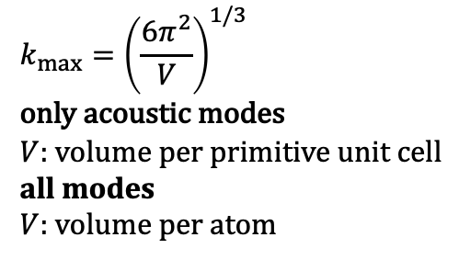
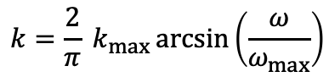
Callaway Modeling
We’ve derived each part of this model in previous lectures.
The spectral version is listed here for reference.
A similar procedure can be performed on a mode specific basis.
$$κ=\frac{1}{3}\int_{0}^{ω_{max}}{C\left(ω\right) v_{g}{\left(ω\right)}^{2} τ(ω)} dω$$
$$k_{max}={\left(\frac{6π^{2}}{V}\right)}^{1/3}$$
only acoustic modes
$V$: volume per primitive unit cell
all modes
$V:$ volume per atom
$$C\left(ω\right)=\frac{3}{2π^{2}}\frac{ω^{4}}{v_{g}v_{p}^{2}}\frac{ℏ^{2}}{k_{B}T^{2}}\frac{e^{ℏω/k_{B}T}}{{\left(e^{ℏω/k_{B}T}−1\right)}^{2}}$$
Dispersion relation:
1) Debye
$$v_{s}={\left(\frac{1}{3v_{L}^{3}}+\frac{2}{3v_{T}^{3}}\right)}^{−1/3}$$
$$ω=v_{s}k$$
$$ω_{max}=v_{s} k_{max}$$
$$v_{g}=\frac{dω}{dk}=v_{s}$$
$$v_{p}=\frac{ω}{k}=v_{s}$$
2) Born von Karman
$$ω=ω_{max}\sin\left(\frac{π}{2} \frac{k}{k_{max}}\right)$$
$$ω_{max}=\frac{2}{π} v_{s} k_{max}$$
$$v_{g}=\frac{dω}{dk}=v_{s}\cos\left(\frac{π}{2}\frac{k}{k_{max}}\right)$$
$$v_{p}=\frac{ω}{k}$$
$$k=\frac{2}{π} k_{max}\arcsin\left(\frac{ω}{ω_{max}}\right)$$
Anderson, O. L. J. Phys. Chem. Solids 24, 909–917 (1963).

Slide 10
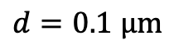
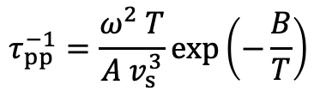
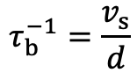
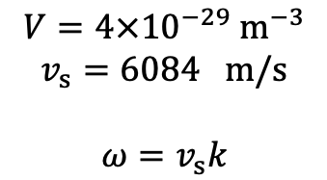
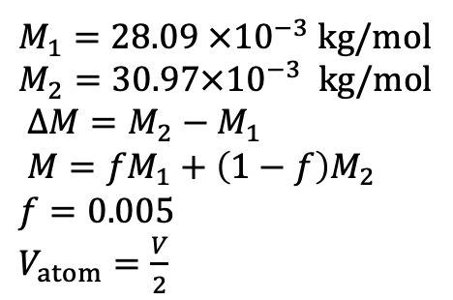
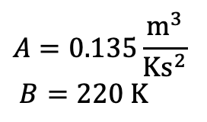
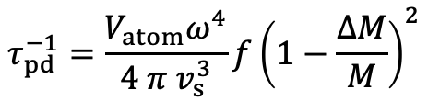
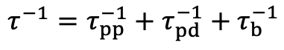
Example Callaway model
Materials values required to reproduce this model
(roughly based on Si)
$$V=4×{10}^{−29} m^{−3}$$
$$v_{s}=6084 m/s$$
$$ω=v_{s}k$$
$$τ^{−1}=τ_{pp}^{−1}+τ_{pd}^{−1}+τ_{b}^{−1}$$
phonon-phonon scattering
point defect scattering
boundary scattering
$$τ_{pp}^{−1}=\frac{ω^{2} T}{A v_{s}^{3}}\exp\left(−\frac{B}{T}\right)$$
$$τ_{pd}^{−1}=\frac{V_{atom}ω^{4}}{4 π v_{s}^{3}}f{\left(1−\frac{ΔM}{M}\right)}^{2}$$
$$τ_{b}^{−1}=\frac{v_{s}}{d}$$
$$A=0.135\frac{m^{3}}{Ks^{2}}$$
$B=220 K$
$M_{1}=28.09 ×{10}^{−3}$ kg/mol
$M_{2}=30.97×{10}^{−3}$ kg/mol
$ΔM=M_{2}−M_{1}$
$M=fM_{1}+\left(1−f\right)M_{2}$
$f=0.005$
$V_{atom}=\frac{V}{2}$
$$d=0.1 μm$$
Tan, G. et al. ACS Energy Lett. 3, 705–712 (2018).
Hanus, R., Garg, A. & Snyder, G. J. Commun. Phys. 1, 78 (2018).

Slide 11
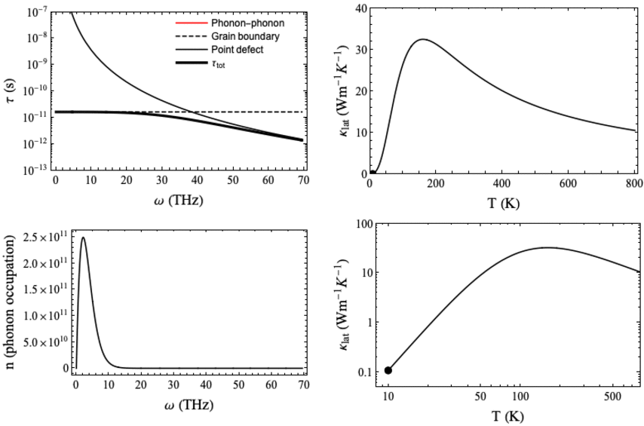
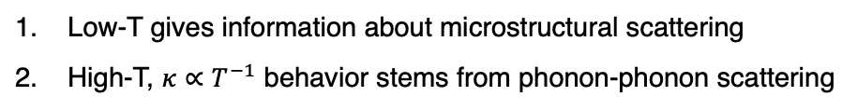
Example Callaway model
Low-T gives information about microstructural scattering
High-T, $κ∝T^{−1}$ behavior stems from phonon-phonon scattering
T ⁻¹
T ³
Notes:
Check units!!

Slide 12
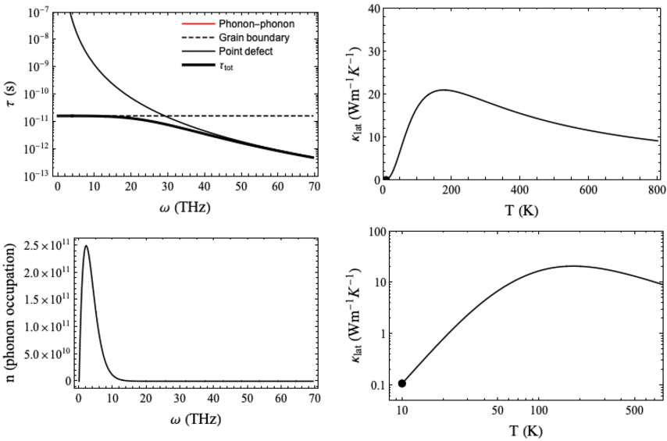
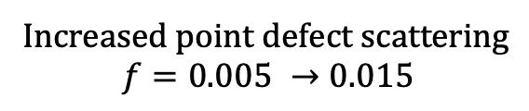
Example Callaway model
Increased point defect scattering
$$f=0.005 →0.015$$

Slide 13
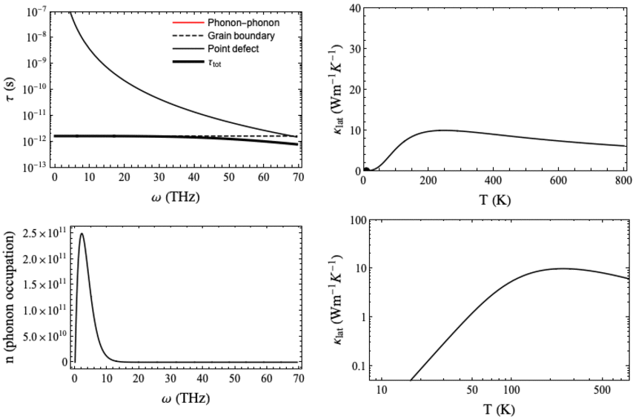
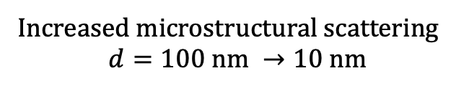
Example Callaway model
Increased microstructural scattering
$$d=100 nm →10 nm$$

Slide 14
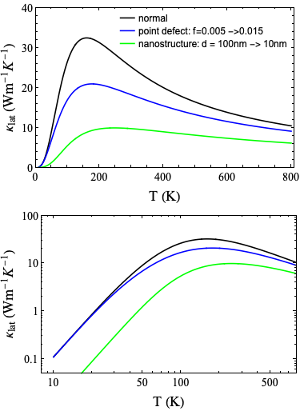
Example Callaway model
Comparing the previous two models
increased point defect scattering vs. increased microstructural scattering

Slide 15
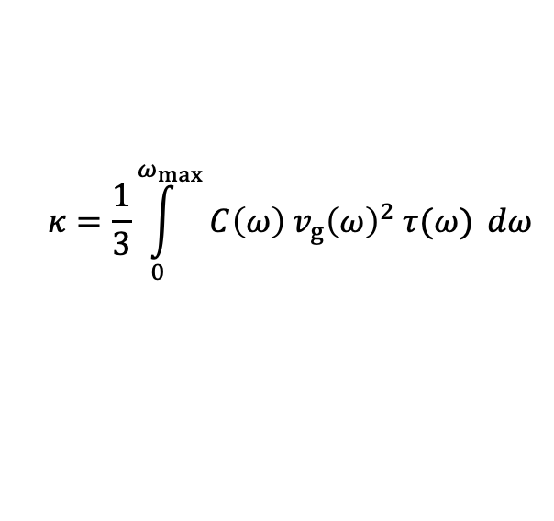
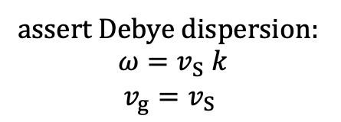
Low-temperature limit
Callaway (spectral) model:
$$κ=\frac{1}{3}\int_{0}^{ω_{max}}{C\left(ω\right) v_{g}{\left(ω\right)}^{2} τ(ω)} dω$$
assert Debye dispersion:
$$ω=v_{S} k$$
${v_{g}=v}_{S}$
exercise
Debye-Callaway model:

Slide 16

Low-T $κ_{L}$ of polycrystalline materials
on board
Low-temperature limit
Case 1:
cst @ low-T
Hanus, R., Garg, A. & Snyder, G. J. Phonon diffraction and dimensionality crossover in phonon-interface scattering. Commun. Phys. 1, 78 (2018).
Wang, Z., et al. Nano Lett. 11, 2206–2213 (2011).
Berman, R. Proc. Phys. Soc. Sect. A 65, 1029–1040 (1952).
Watari, K. et al. J. Mater. Res. 17, 2940–2944 (2002).

Slide 17
Low-T $κ_{L}$ of polycrystalline materials
on board
Low-temperature limit
Case 2:
cst @ low-T
Hanus, R., Garg, A. & Snyder, G. J. Phonon diffraction and dimensionality crossover in phonon-interface scattering. Commun. Phys. 1, 78 (2018).
Wang, Z., et al. Nano Lett. 11, 2206–2213 (2011).
Berman, R. Proc. Phys. Soc. Sect. A 65, 1029–1040 (1952).
Watari, K. et al. J. Mater. Res. 17, 2940–2944 (2002).

Slide 18
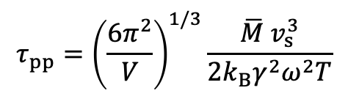
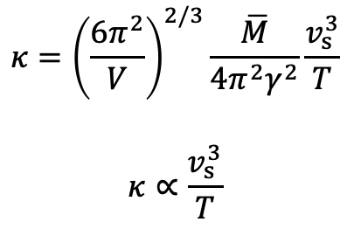
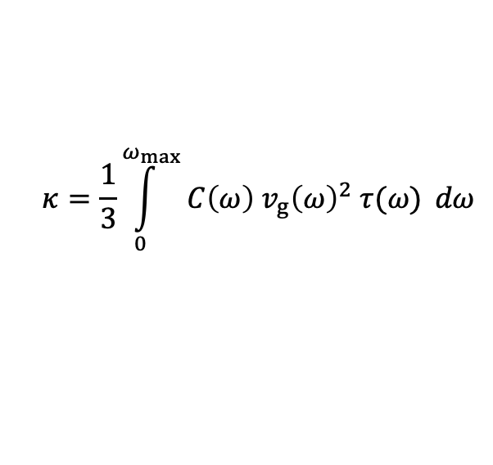
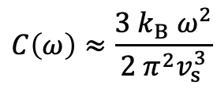
High-temperature limit
Assert the following form of phonon-phonon scattering, and Debye dispersion
$$τ_{pp}={\left(\frac{6π^{2}}{V}\right)}^{1/3}\frac{\overline{M} v_{s}^{3}}{2k_{B}γ^{2}ω^{2}T}$$
Refs: Slack, G. A. & Galginaitis, S. Phys. Rev. 133, (1964).
Toberer, E. S., et al. J. Mater. Chem. 21, 15843 (2011).
Make high temperature approximation ($T>Θ_{D}$) for $C(ω)$
$$C\left(ω\right)≈\frac{3 k_{B} ω^{2}}{2 π^{2}v_{s}^{3}}$$
$$κ={\left(\frac{6π^{2}}{V}\right)}^{2/3}\frac{\overline{M}}{4π^{2}γ^{2}}\frac{v_{s}^{3}}{T}$$
$$κ∝\frac{v_{s}^{3}}{T}$$
$$κ=\frac{1}{3}\int_{0}^{ω_{max}}{C\left(ω\right) v_{g}{\left(ω\right)}^{2} τ(ω)} dω$$
exercise
Hanus, R. et al. Lattice Softening Significantly Reduces Thermal Conductivity and
Leads to High Thermoelectric Efficiency. Adv. Mater. 1900108, 1900108 (2019).

Slide 19
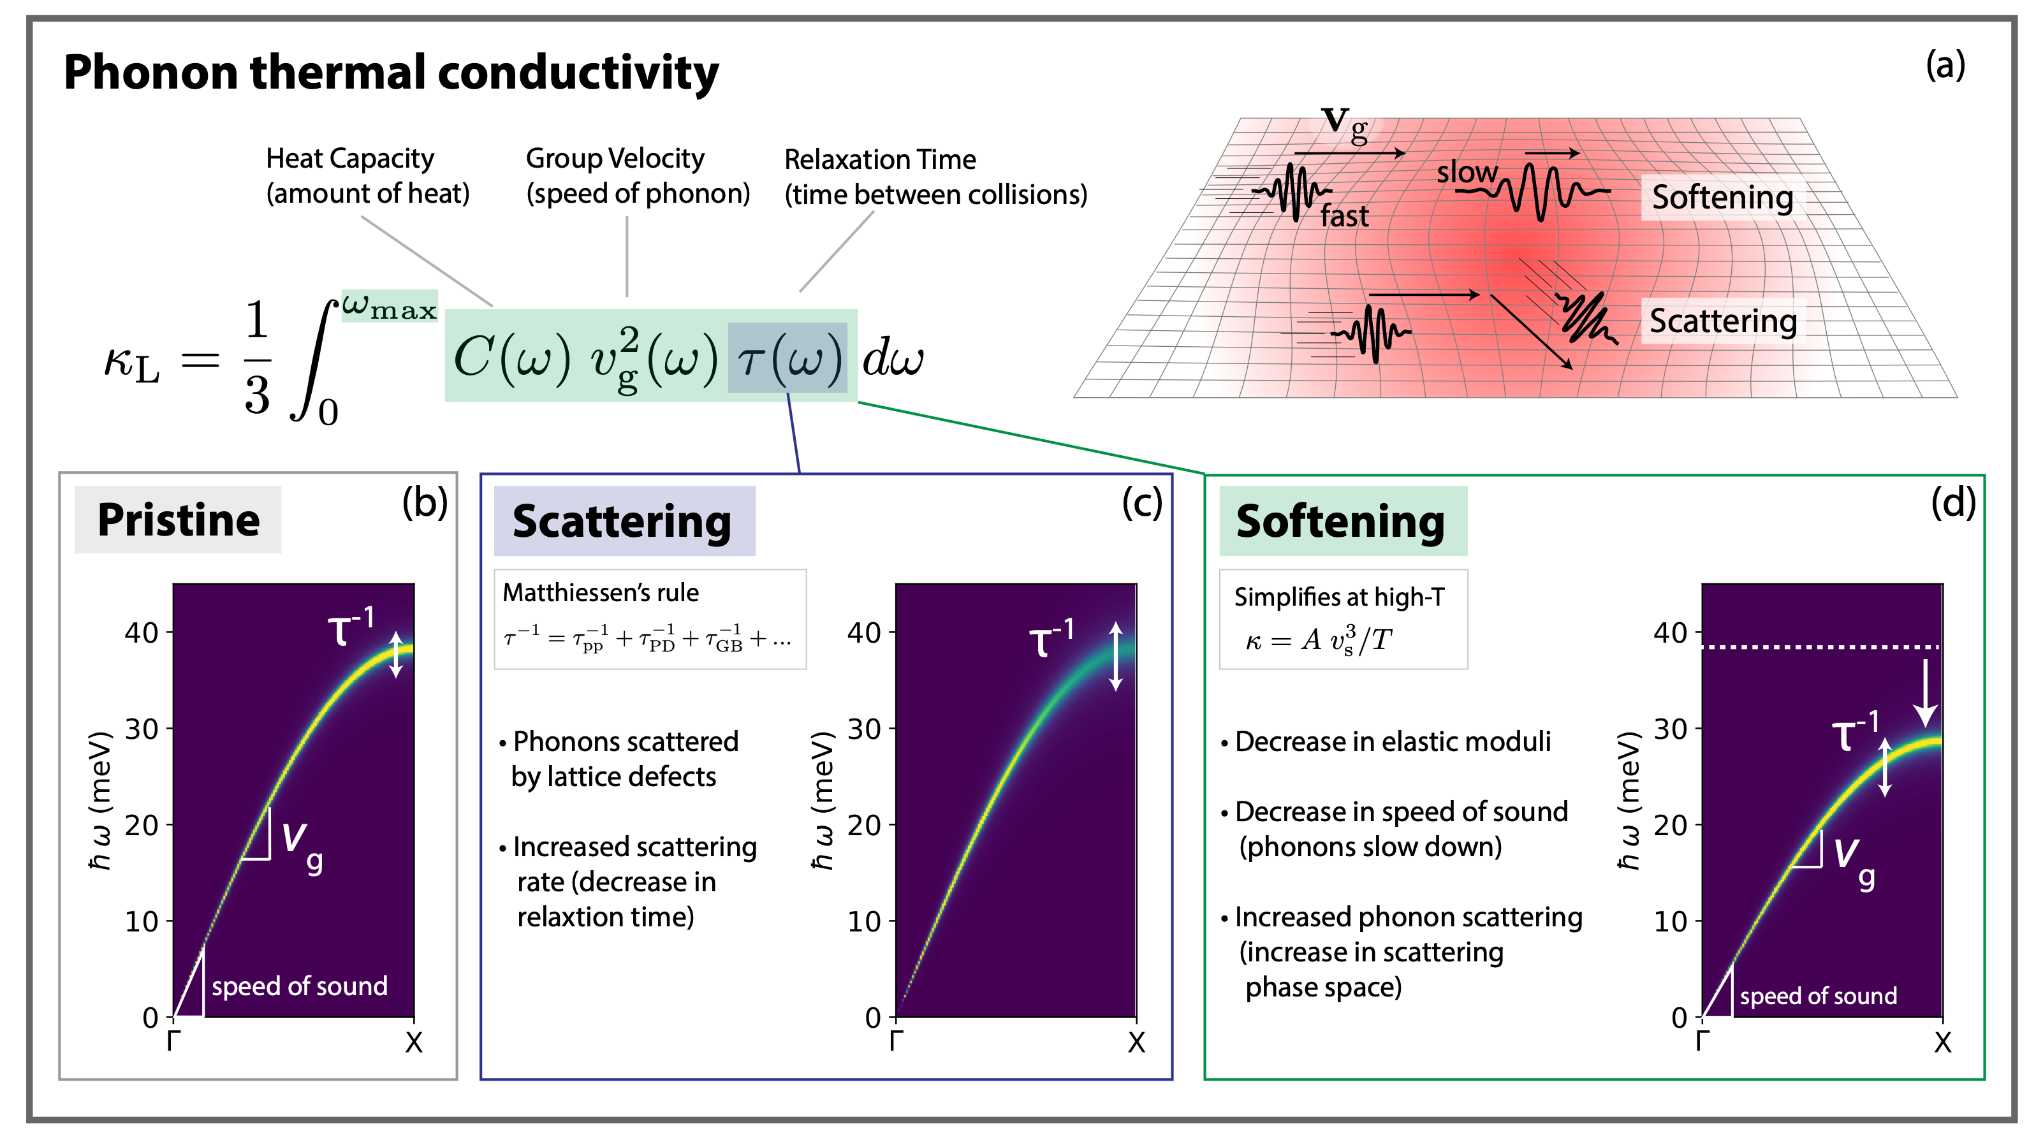
Phonon scattering vs. Elastic (lattice) softening

Slide 20
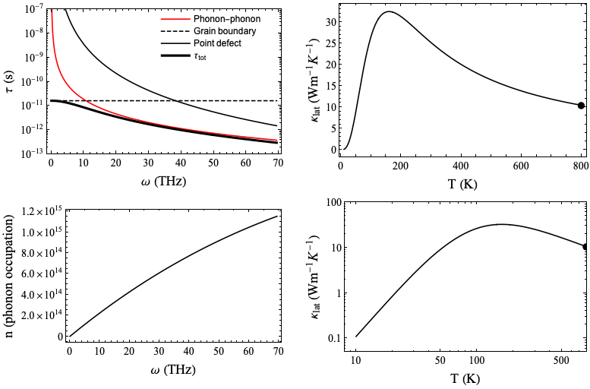
When is softening expected to be important?
Anharmonic materials
High temperatures
800 K, phonon-phonon scattering dominates

Slide 21
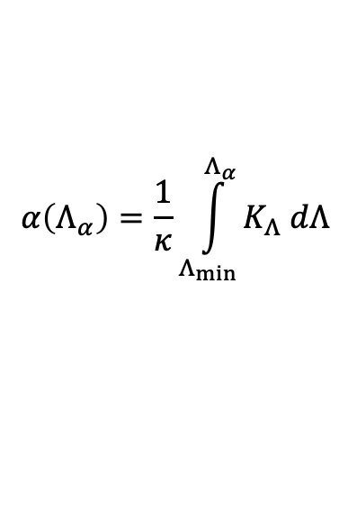
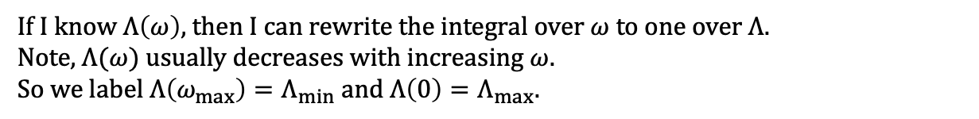
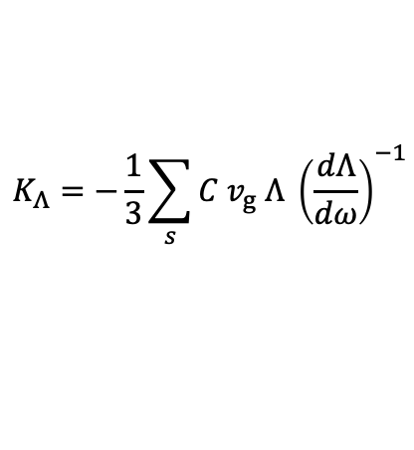
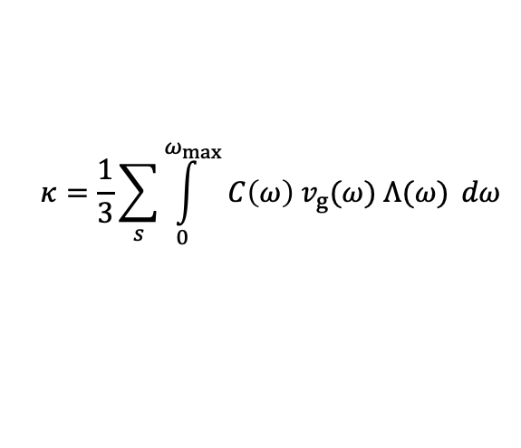
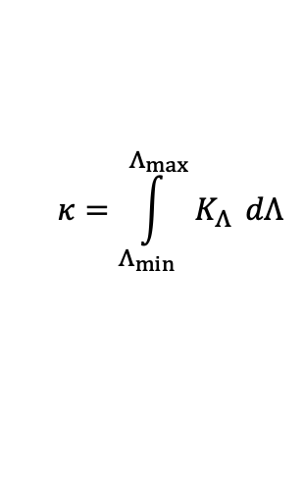
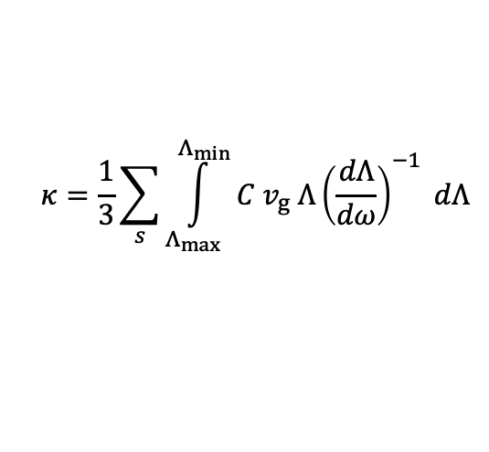

on board
Accumulation plots
$$κ=\frac{1}{3}\sum_{s}{\int_{0}^{ω_{max}}{C\left(ω\right) v_{g}(ω) Λ(ω)} dω}$$
If I know $Λ\left(ω\right)$, then I can rewrite the integral over $ω$ to one over $Λ$.
Note, $Λ(ω)$usually decreases with increasing $ω$.
So we label $Λ\left(ω_{max}\right)=Λ_{min}$ and $Λ\left(0\right)=Λ_{max}.$
$$κ=\frac{1}{3}\sum_{s}{\int_{Λ_{max}}^{Λ_{min}}{C v_{g} Λ{\left(\frac{dΛ}{dω}\right)}^{−1}} dΛ}$$
Flip the limits, which spits out a negative sign, and package up the integrand into $K_{Λ}$
$$κ=\int_{Λ_{min}}^{Λ_{max}}{K_{Λ}} dΛ$$
$$K_{Λ}=−\frac{1}{3}\sum_{s}{C v_{g} Λ {\left(\frac{dΛ}{dω}\right)}^{−1}}$$
Now define the “Normalized accumulation function”
$$α\left(Λ_{α}\right)=\frac{1}{κ}\int_{Λ_{min}}^{Λ_{α}}{K_{Λ} dΛ}$$
plot from $Λ_{α}=Λ_{min}$ to $Λ_{max}$
Yang, F. & Dames, C. Mean free path spectra as a tool to understand thermal conductivity in bulk and nanostructures. Phys. Rev. B - Condens. Matter Mater. Phys. 87, 1–12 (2013).

Slide 22

Intrinsic phonon mean free path
Accumulation plots
Example
75% of the heat is carried by phonons with a mean free path less than 1000 nm in Si, and less than 5 nm in PbTe
PbTe
~ 5 nm
Si
~ 1000 nm
Liu, Z., Mao, J., Liu, T.-H., Chen, G. & Ren, Z. MRS Bull. 43, 181–186 (2018).

